Slide 1
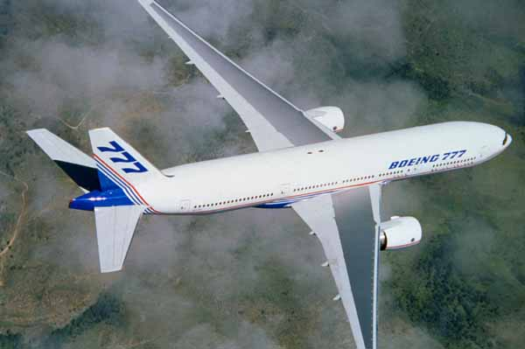
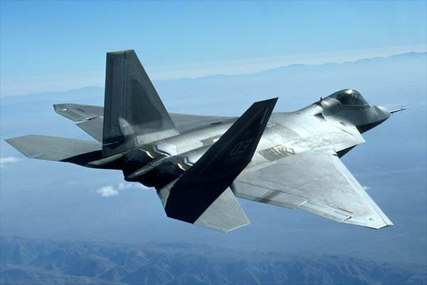
ASPECT RATIO
High subsonic / transonic aircraft require signifigant sweepback to increase Mcrit.
The sweepback (27 degrees) dramatically increases induced drag, requiring a higher aspect ratio.
The inevitably required stronger wing structure increases mass and compressibility (wave) drag.
Costs / benefits of aspect ratio and sweepback must be matched with design purpose (diagrams)
At low transonic speeds,
wings with high aspect
ratio can be used.
At high transonic or supersonic
speeds, wings with low aspect
ratio are used.

Slide 2
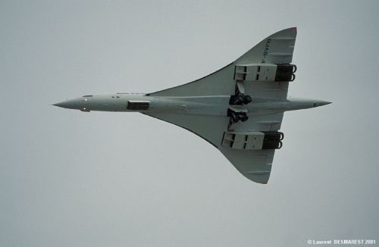
DELTA WING
Deltas achieve a low thickness / chord ratio (despite the thick wing) with low aspect ratio.
Retention of low thickness / chord ratio combined with delta shape retains a stronger wing.
High crescent sweepback angle combined with low thickness chord ratio produces high Mcrit
The delta wing produces very high levels of induced drag, particularly at lower subsonic speeds.
Concorde has a very high
M_{crit} and very low
transonic drag
Notes:
‹#›

Slide 3
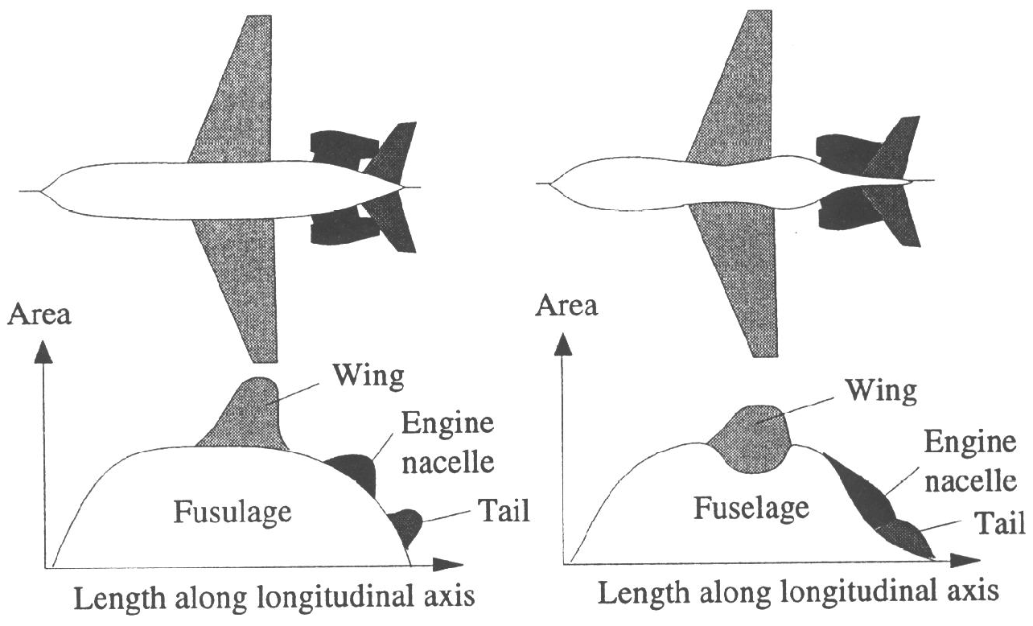
WAVE DRAG AND AREA RULE
The shock wave from one component on an aircraft can cause flow separation on another - this extra drag is called wave drag.
Wave drag can be minimised at transonic speeds by “smoothing” the cross sectional area change along the longitudinal axis.
The concept is similar to subsonic streamlining – the total cross sectional area change along the axis follows a smooth path.
Note the fuselage “ waist”
Notes:
‹#›

Slide 4
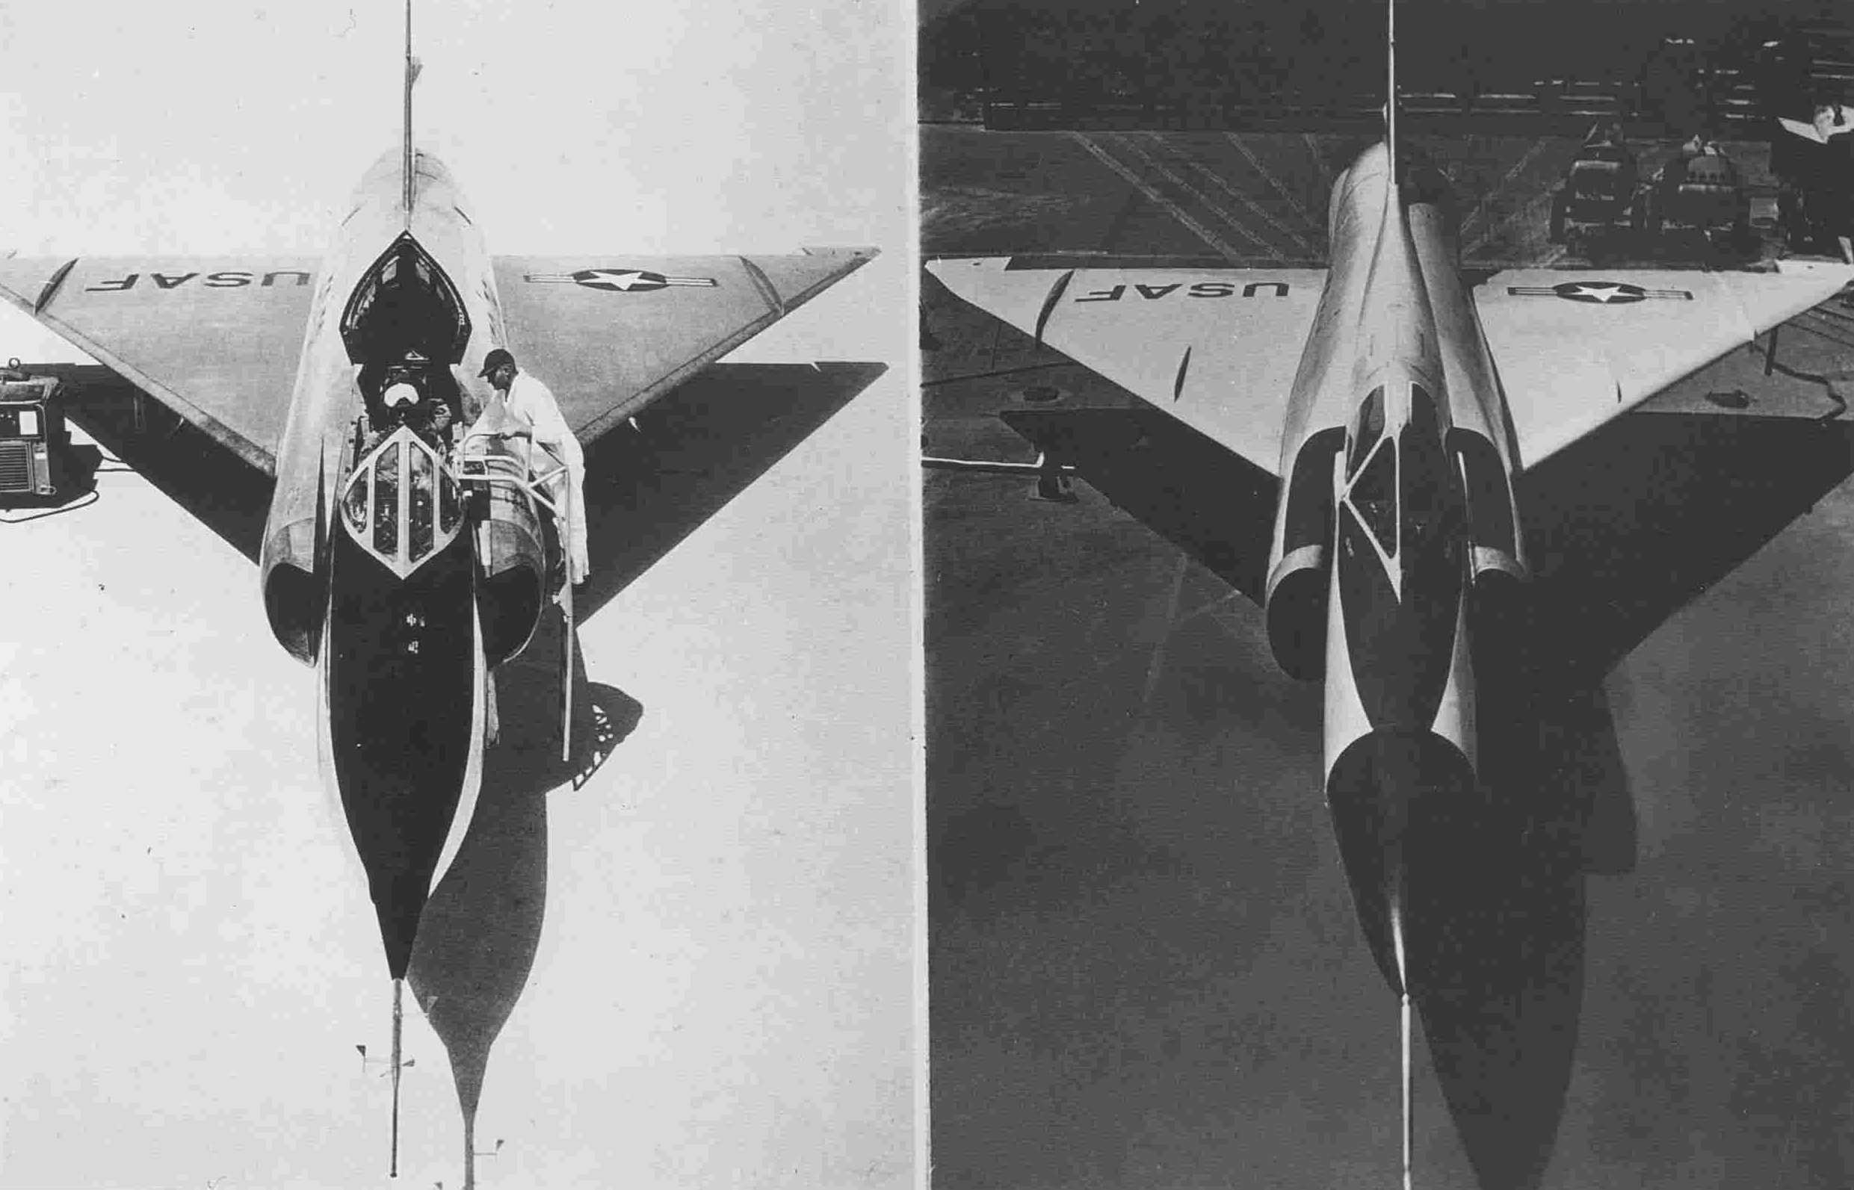
WAVE DRAG AND AREA RULE (cont’d)
The original F102 interceptor on the left lacked area rule design and could not exceed Mach 1 because of transonic drag rise.
The “area rule” redesigned YF102 interceptor on the right attained Mach 1.25 using the same engine – note the “waist”.
BEFORE
AFTER
Notes:
‹#›

Slide 5
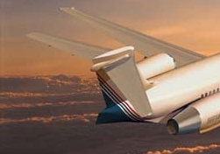
THE TAILPLANE
Shock wave mitigation is even more important on the tail than on the main wing - Mcrit needs to be higher,
and a higher sweepback angle is therefore normally obvious.
The other methods of increasing Mcrit on the main wing (such as thin aerofoils) can also be used on the tail.

Slide 6
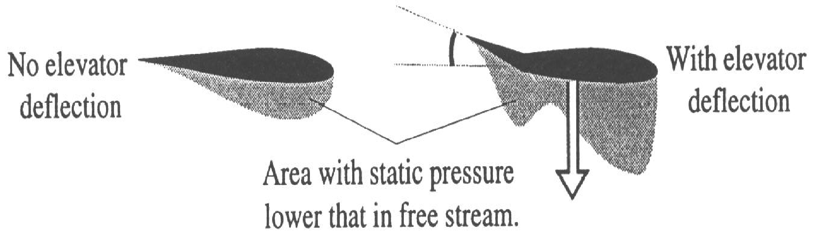
REDUCED ELEVATOR EFFECTIVENESS
AT SUBSONIC FLOW VELOCITIES, ELEVATOR MOVEMENT CHANGES PRESSURE DISTRIBUTION
BY TRANSMITTING PRESSURE WAVES WELL AHEAD OF THE AIRCRAFT – THE RELATIVE
AIRFLOW MAKES SMOOTH, SMALL PATH ADJUSTMENTS WELL BEFORE PASSING THE TAIL .

Slide 7
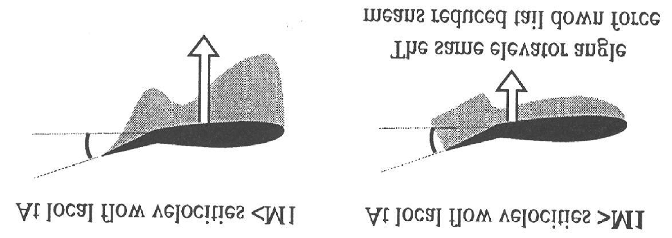
REDUCED ELEVATOR EFFECTIVENESS (cont’d)
Flying at high transonic or supersonic velocities, the elevator “keeps pace with” or exceeds the pressure wave
transmission which is no longer ahead of the aircraft.
There is no relative airflow adjustment ahead of the elevator.
The total effect of any given elevator deflection is therefore much smaller at supersonic or transonic velocity.
A larger elevator deflection is therefore required to produce the same control effect.
The centre of pressure of the elevator moves aft to roughly 50% chord at transonic / supersonic velocities.
Consequently the pressure pattern is more rectangular rather than triangular.
Notes:
‹#›

Slide 8
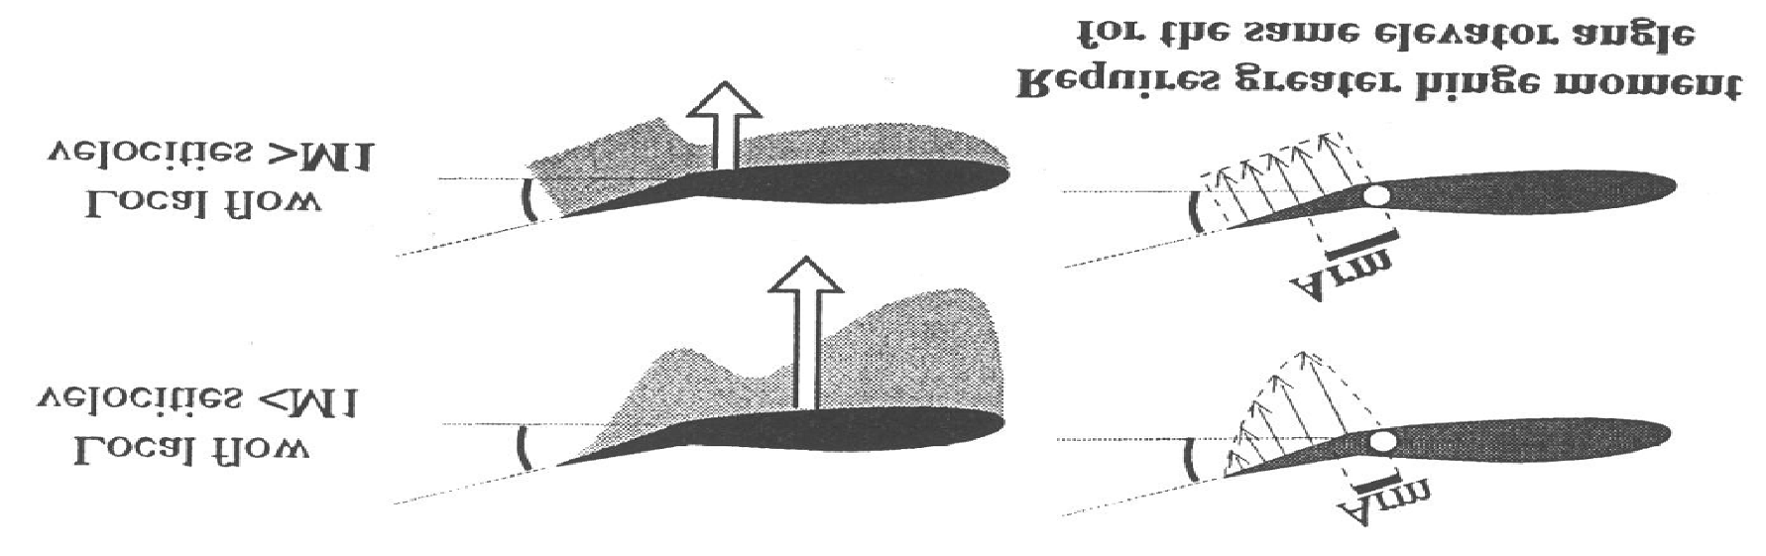
REDUCED ELEVATOR EFFECTIVENESS (cont’d)
The physics of supersonic flow are completely different of from those of subsonic flow. The result is the more rectangular pressure pattern and centre of pressure located at roughly 50% chord as illustrated.
Movement of the elevator for whatever reason means that a resistance moment of AERODYNAMIC FORCE MULTIPLIED BY CENTRE OF PRESSURE DISTANCE FROM THE HINGE LINE must be overcome.
A given elevator deflection therefore gives a much higher moment at transonic / supersonic velocity than at subsonic velocity. The effectiveness of the elevator is also reduced for a given deflection.
Required elevator deflection is much higher in order to achieve the same result.
The stick forces required to trim or manoeuvre an aircraft at high transonic or supersonic speeds may become
prohibitive.

Slide 9
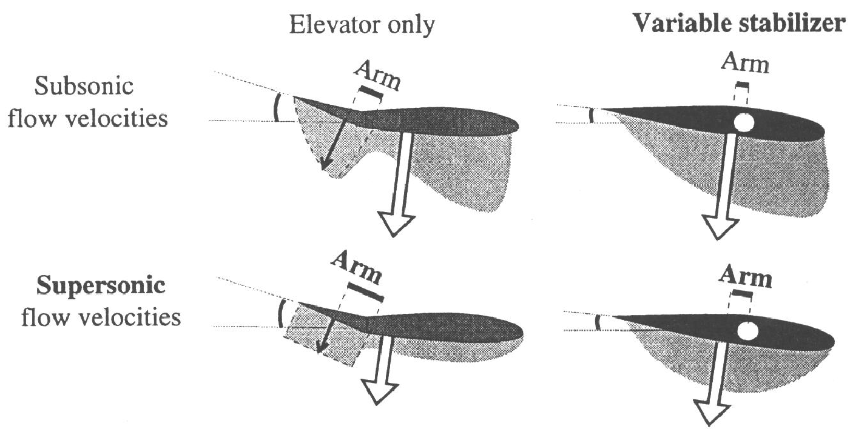
USE OF VARIABLE INCIDENCE STABILISER
The use of separately hinged elevator and also a separate trim tab create a predisposition to shock wave formation on those relatively small separate surfaces, due to the large deflection angles required in different directions.
The larger distance from the hinge points to the centre of pressure of each separate surface create heavy hinge moments.
Early types of variable incidence horizontal stabilisers used a separate elevator, but the stabiliser angle of incidence was controlled by the cockpit pitch trim wheel. The result was less trim drag and shock wave activity due to the minute angular
stabiliser deflection.

Slide 10
VARIABLE INCIDENCE TAILPLANES
The common method of pitch control on large aircraft is to control the elevator and trim the stabiliser
The autopilot and mach trimmer both control with the variable incidence stabiliser.
VARIABLE INCIDENCE TAILPLANE
TRIM
WHEEL
STABILISER
ELEVATOR
AIRCRAFT STRUCTURE
ALL FLYING TAILPLANE
When the stabiliser moves a cam is pushed to position the elevator
CAM
The all flying tail method is to control and trim the stabiliser
STABILISER
STABILISER
ELEVATOR
TRIM
WHEEL
The elevator acts as an anti -balance tab, reducing the
possibility of over control.
AIRCRAFT STRUCTURE
‹#›

Slide 11
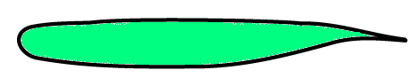
MACH TUCK
Above Mcrit, higher relative airflow acceleration at the thicker wing roots initiates earlier shock formation, much
lower lift coefficient and downwash at the roots; before the shocks spread laterally outward (diagram below right).
Shock growth / rearward movement rearward centre of pressure movement @ supersonic to roughly 50%chord.
Reduction in wing root downwash reduces download at the tail.
Swept wing geometry means that outward centre of pressure movement is also rearward.
These four factors produce a strong nose down pitching moment called “mach tuck” or “tuck under”.
Supercritical wing reflex camber as illustrated below increases rearward
centre of pressure movement.
SUPERCRITICAL WING
Rearward centre of pressure movement
Reflex camber
Mach tuck is resolved by the modern aircraft autopilot
which is designed to include 2 sub functions:
Tailplane download to control mach tuck;
Tailplane upload in the event of approach to the stall.

Slide 12
HIGH SPEED STABILITY
MACH TUCK
Mach Tuck or “Tuck Under” may occur in aircraft flying at speeds above Mcrit. Due to a significant rearward movement of the Centre of Pressure the aircraft may develop an uncontrollable nose down motion. To correct this an independent system is provided and is called the MACH TRIM SYSTEM.
Information comes from the Air Data Computer (MACH)
A/P ENGAGE
L C R
CMD
CMD
CMD
MACH TRIM SYSTEM
If you engage the autopilot
or manually trim the aircraft
the MACH TRIM is inhibited
INHIBITED
MACH TRIM SYSTEM
STAB TRIM
STAB TRIM
HYD SYST 2
A
B
HYD SYST 3
HYDRAULIC MOTORS
SCREWJACK
STABILISER

Slide 13
SUMMARY OF PITCH TRIMS
In some aircraft these two are one system combined and called the “Alpha Trim” or “Angle of Attack Trim”
MACH TRIM SYSTEM
Trims to stop MACH TUCK
Trims to help low
speed stability
SPEED STABILITY SYSTEM
A/P ENGAGE
L C R
AUTO TRIM
CMD
CMD
CMD
MANUAL TRIM
PILOT TRIM
OR
AUTOTRIM
STAB TRIM
STAB TRIM
HYD SYST 2
A
B
HYD SYST 3
HYDRAULIC MOTORS
SCREWJACK
STABILISER

Slide 14
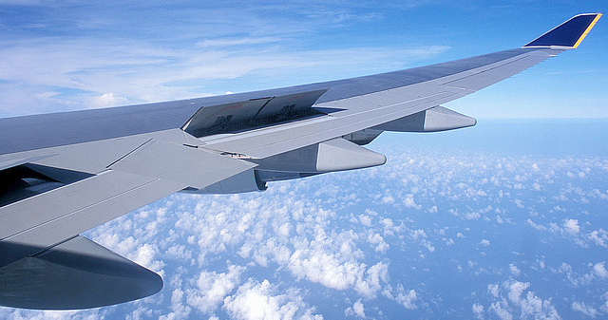
AILERON CONTROL REVERSAL PROBLEMS SPOILERS
The centre of pressure of a conventional low speed aileron is a large distance from the wing torsional axis,
creating a wing twisting moment as the aileron is deployed. At high speed (dynamic pressure), aileron deployment is sufficient to twist the wing, changing the wing angle of incidence in the opposite sense to aileron input.
In the photograph, right aileron application deploys the right wing spoiler up, reducing lift / increasing drag coefficient on the
right wing and achieving the desired result without torsional twisting of either wing.
Notes:
‹#›

Slide 15
AILERON CONTROL - SPOILERS
Unequal shock wave formation can cause disturbances in the rolling plane in aircraft not designed transonic / supersonic. If
the aircraft is transonic or faster, ailerons move faster than pressure wave transmission, causing loss of effectiveness. The
problem is aggravated severely by flow separation. Differential spoilers are effective mitigants
This aircraft has no spoilers and therefore aileron rolls occur around the longitudinal axis of the aircraft
This aircraft has spoiler augmentation on the down going wing which falls pivoting on the wing, not the longitudinal axis.
Application of opposite roll changes the pivot point to the other wing.

Slide 16
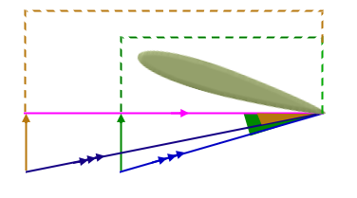
EFFECT OF ALTITUDE INCREASE ON DIRECTION AND LONGITUDINAL STATIC STABILITY
DEFINITION: THE TENDANCY OF AN AIRCRAFT TO RETURN TOWARDS THE ORIGINAL TRIMMED STATE AFTER DISTURBANCE IN THE
DIRECTIONAL OR LONGITUDINAL PLANE
Stabilising moment in these planes is provided by the coefficient of aerodynamic force induced at the vertical / horizontal
stabiliser, multiplied by the stabiliser centre of pressure distance from the relevant axis / centre of gravity.
Comparing identical values of EAS in the same aircraft from sea level to high altitude; the TAS vector increases, reducing the
angle of attack induced at the vertical / horizontal stabilisers by identical linear displacements at the vertical / horizontal
stabilisers. DIRECTIONAL AND LONGITUDINAL STATIC STABILITY BOTH REDUCE WITH ALTITUDE FOR A CONSTANT EAS,
WHILE LATERAL STABILITY REMAINS UNCHANGED
TAS VECTOR AT HIGH ALTITUDE
Angles of attack induced
at vertical / horizontal
stabilisers
TAS VECTOR AT LOW ALTITUDE
Identical linear displacement
vectors at vertical / horizontal
stabilisers
Vector for resultant high altitude relative airflow
Low altitude resultant relative airflow vector

Slide 17
DISADVANTAGES OF THE SWEPT WING – LIFT / DRAG
For any given angle of attack, lift is reduced as the cosine of sweepback angle increased angle of attack.
Increased angle of attack higher induced drag poorer lift / drag ratio.
Red component parallel to torsional
axis is span wise flow above and below the
wing, and is aerodynamically problematic.
Blue component NORMAL to torsional axis
produces reduced lift.- function of cosine
of sweepback angle
Torsional Axis
Sweepback Angle
Relative airflow
Relative airflow
Notes:
‹#›

Slide 18
DISADVANTAGES OF THE SWEPT WING – SPANWISE FLOW
The diagram below of a supercritical wing cross section illustrates adverse pressure gradient in the direction
Illustrated from the blue square towards the red square.
The relative positions of the two squares can now be transposed to their corresponding positions on the wing
plan form shown in the next slide.
Note that the flatter upper surface of a supercritical wing does reduce the intensity of adverse pressure gradient.
Relative airflow decelerates.
Static pressure increases.
Relative airflow accelerates.
Static pressure reduces.
Adverse pressure gradient
Reflex camber

Slide 19
DISADVANTAGES OF THE SWEPT WING – SPANWISE FLOW
Adverse pressure gradient transposed from the previous slide creates a spanwise pressure gradient in the direction indicated by the arrows over the wing upper surface from the blue squares to the red squares.

Slide 20
DISADVANTAGES OF THE SWEPT WING – INDUCED DRAG / TIP STALLING
The three flow patterns are indicated in three different colours above and below the wings. Aerodynamic interference occurs
between the flows, mostly concentrated around the wing tip areas, and producing turbulent airflow / vortices – the concept is
similar to that of interference drag considered early in low speed aerodynamics courses.
The result is that “RAM’S HORN VORTICES” are formed, large at the wing tips and reducing in size approaching the wing roots.
The flow patterns and vortices mean that:
1. Swept wings have much higher levels of induced drag than straight wings at the same angle of attack; and
2. Swept wings stall at the wing tips before the wing roots, moving centres of pressure towards the roots, and therefore forward.
Normal induced drag flow patterns
Adverse pressure gradient airflow
Adverse pressure gradient airflow
Span wise flow above
and below the wings.

Slide 21
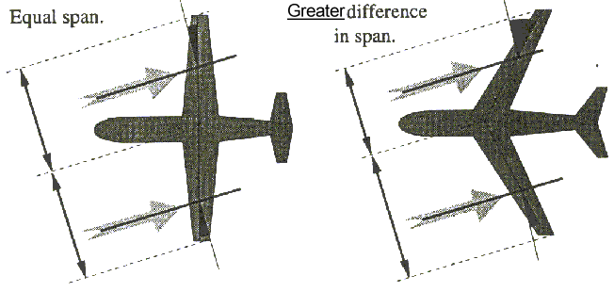
DISADVANTAGES OF SWEPT WINGS / SIDESLIP CHARACTERISTICS
The previous four slides should have produced an understanding as to the reason for dramatically reduced lift coefficients and
increased induced drag coefficients of swept wings compared to straight wings at the same angle of attack.
While a straight wing aircraft can be sideslipped quite effectively and safely, a swept wing has a very high level of lateral stability
which can cause it to roll rapidly in the “lee”( to the right in the diagram) direction of the sideslip (which is left in the diagram).
The roll is maintained in this example by left aileron, but the diagram illustrates exaggerated sweepback on the higher wing of the
swept wing aircraft – the long track of relative airflow over this wing thickens and de energises its boundary layer.
This can reduce aileron effectiveness and cause the aircraft to rapidly roll (right) to the lee of the sideslip.

Slide 22
DISADVANTAGES OF THE SWEPT WING – DUTCH ROLL
BOTH AIRCRAFT ARE SHOWN ROLLING / SLIPPING TO THE RIGHT, BUT EXAGGERATED SWEEPBACK / INDUCED DRAG YAWS THE AIRCRAFT TO THE LEFT – HIGH LATERAL STABILITY THEN REVERSES THE PROCESS, RESULTING IN DUTCH ROLL.
RELATIVE AIRFLOW
THE STUDENT CAN USE A CHEAP SWEPT MODEL AND DEMONSTRATE DUTCH ROLL TO HIM / HER SELF
RELATIVE AIRFLOW

Slide 23
DUTCH ROLL
Dutch roll, particularly in turbine powered airline aircraft is simultaneous yaw and roll in opposite directions, and is
oscillatory in nature.
The aircraft rolls and sideslips in the same direction. Induced drag on the up going wing causes opposite direction
yaw.
High lateral stability, coupled with weak directional
stability then reverses the process.
Yaw dampers are required to prevent “Dutch Roll” on swept wing aircraft.
There are normally TWO fitted working simultaneously.
ONE yaw damper is sufficient if the other fails.

Slide 24
VARIATION OF THE DUTCH ROLL – “FISH TAILING”
The aircraft in this example is now assumed to be of different load disposition with much further forward C.G than
in the 2 previous slides, with possible better spanwise flow mitigation (maybe with wing fences and /or vortilons).
This produces more directional stability, and yaw direction results from directional +ve and –ve moment addition.
The roll / sideslip still reduces apparent sweepback on the lower wing (to zero in this example), thus increasing lift.
Induced drag is proportional to lift coefficient squared, and increases on the lowered wing more than the raised
wing, causing the aircraft to yaw in the direction of the roll /sideslip.
Excess lateral stability causes reversal of the roll and the whole process is reversed.
Apparent sweepback
zero. Higher CL, hence
higher induced drag
Forward C of G
increases
directional stability
Spanwise flow
mitigated by wing
fences / vortilons-
less induced drag.
If + ve clockwise yaw moment
exceeds – ve anticlockwise
moment, “fishtail” into airflow.
Notes:
‹#›

Slide 25
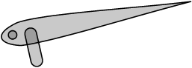
YAW DAMPING
A rate gyro senses yaw and signals the yaw damper controller to move the yaw damper actuator to eliminate the yaw.
RATE
GYRO
YAW
DAMPER
ELEC
INPUT
HYD
HYD
NORMAL
RUDDER ACTUATOR
YAW DAMPER ACTUATOR
YAW DAMPER
UPPER
LOWER
ON
ON
Yaw dampers are monitored and have a failure light
INOP
INOP
PILOTS OVERHEAD PANEL

Slide 26
YAW DAMPER TYPES
ON
RATE
GYRO
YAW
DAMPER
YAW
DAMPER
OFF
ELEC
INPUT
PARALLEL
HYD
yaw damping DOES move the rudder pedals
NORMAL ACTUATOR
YAW DAMPER
RATE
GYRO
YAW
DAMPER
ON
INOP
SERIES
ELEC
INPUT
HYD
HYD
yaw damping DOES NOT move the rudder pedals
YAW DAMPER ACTUATOR
NORMAL ACTUATOR
The yaw damper actuator only moves the rudder
this type is used on modern aircraft

Slide 27

INERTIA AND TURNING PERFORMANCE
For a constant EAS, TAS increases dramatically during operations at high altitude, compared to sea level.
For a given angle of bank, radius of turn increases with the TAS, and is therefore much higher at altitude.
For a given angle of bank (normally 20 degrees maximum at altitude) rate of turn reduces with increase in TAS.
The high inertia means that an aircraft at very high altitude will require a large amount of airspace to turn.
Instrument departure and arrival documents reflect these requirements.
High inertia, particularly at altitude means that a change in pitch attitude requires a large distance to effect
a change in vertical flight path. An abrupt attitude change can cause an “inertia stall”

Slide 28
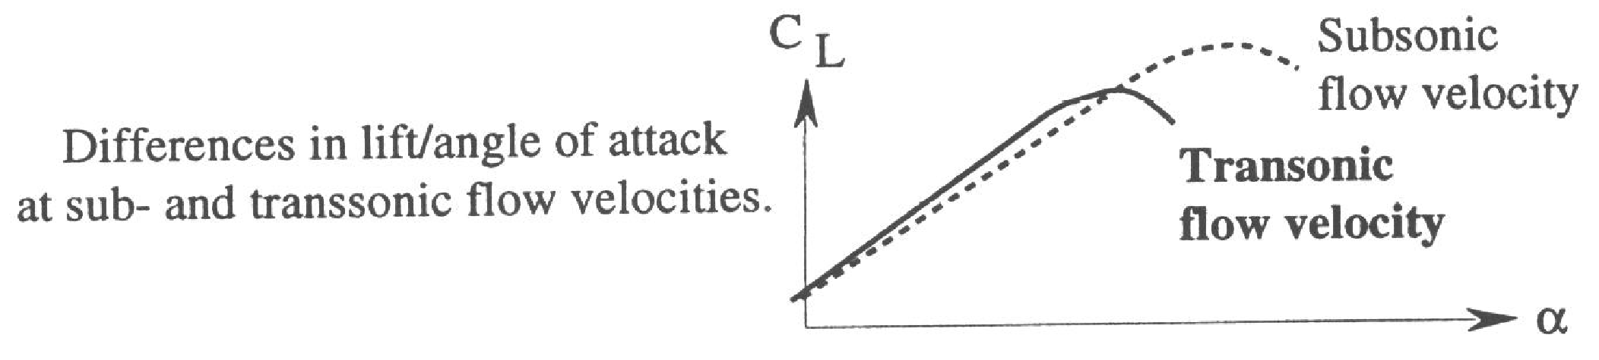
THE SPEED ENVELOPE
This slide is a repeat of Slide 32 in Part 1 to remind the student of the reason for lower critical
angles of attack in faster aircraft, particularly at high flight levels leading to high TAS.
For a given EAS, increasing angle of attack increases acceleration of relative airflow over
the wing, thus increasing local Mach number at the point of maximum camber.
At higher Mach numbers this acceleration can cause the flow to become sonic at angles of attack
signifigantly less than the normal stalling angle.
The symptoms of the inevitable shock wave include flow separation and all other problems
associated with supersonic flow in a high speed subsonic aircraft.
At high subsonic Mach numbers the maximum angle of attack and therefore CL max are both
lower than at slower Mach numbers.
This affects the flight envelope in which the aircraft can operate.

Slide 29
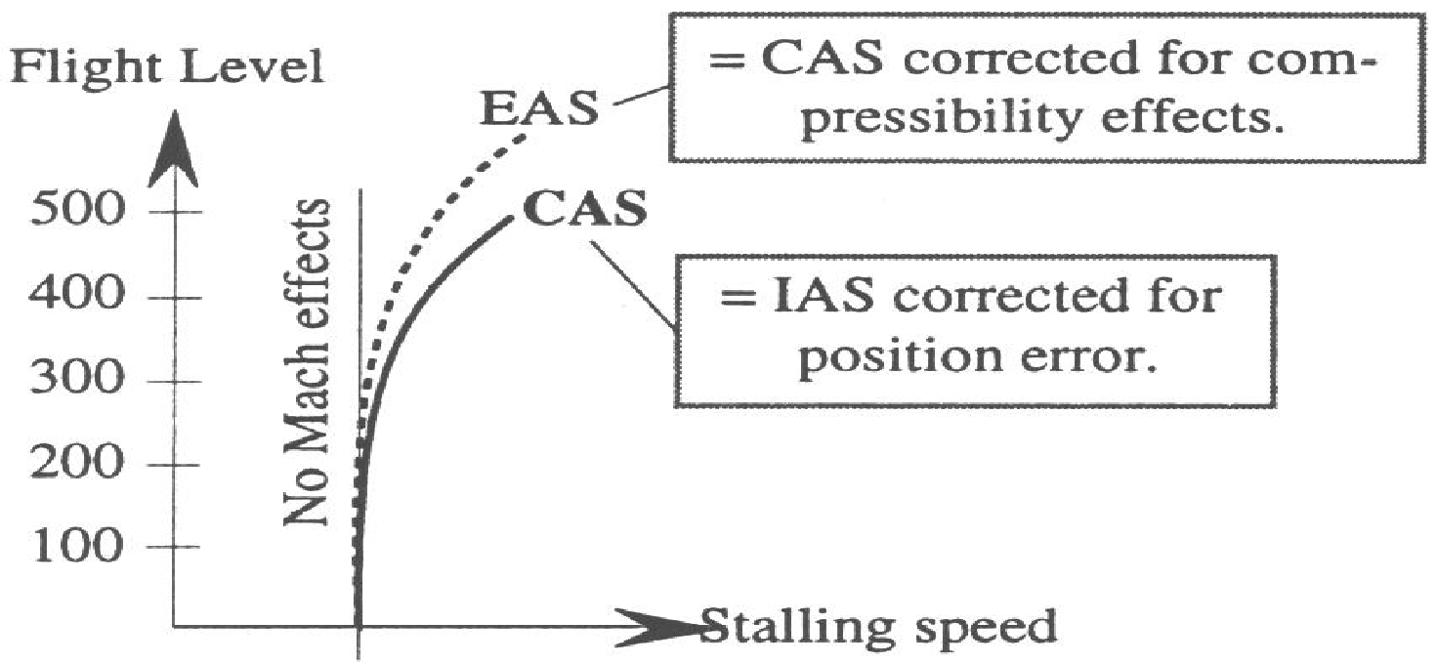
THE SPEED ENVELOPE (cont).
Pilots are generally taught in their early flying training on lower speed / altitude aircraft that CAS stalling speed remains constant
with altitude.
The diagram below demonstrates this to be correct only for the low TAS / altitude end of subsonic flight.
Vs, if measured at EAS, is the minimum (load factor1) speed at which level flight is sustainable. The critical angle and therefore CLmax both reduce at high altitude due to the high TAS and consequent compressibility issues: thus (EAS) Vs increases
(The stick shaker activates at 1.05Vs). Compressibility correction means that Vs readout as IAS is even higher.
The diagram below indicates the result of these issues with the low speed buffet boundary EAS increasing; therefore with CAS
and consequent IAS increasing even more markedly at higher flight levels.
Notes:
‹#›

Slide 30
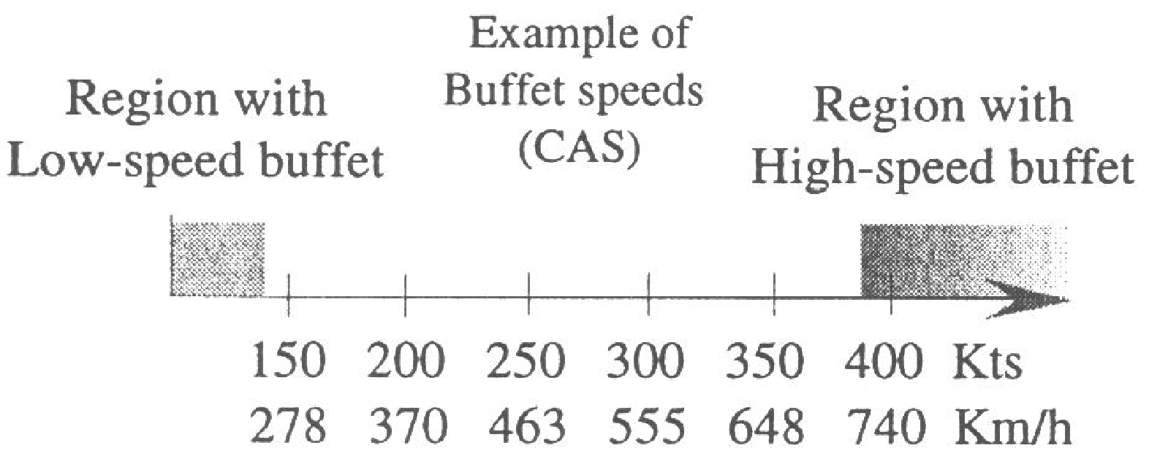
THE SPEED ENVELOPE
Any high performance turbine aircraft will encounter high speed compressibility issues at high values of IAS / CAS, particularly
at higher altitudes where higher atmospheric density corrections produce much higher TAS values approaching or above Mcrit.
FORCE DIVERGENT MACH NUMBER IS THE MACH NUMBER ABOVE Mcrit WHICH RESULTS IN LARGE CENTRE OF
PRESSURE CHANGES AND PITCHING TENDENCIES (MACH TUCK).
The lower speed end of the speed envelope is referred to as low speed buffet, and the other end is referred to as high speed
buffet.

Slide 31
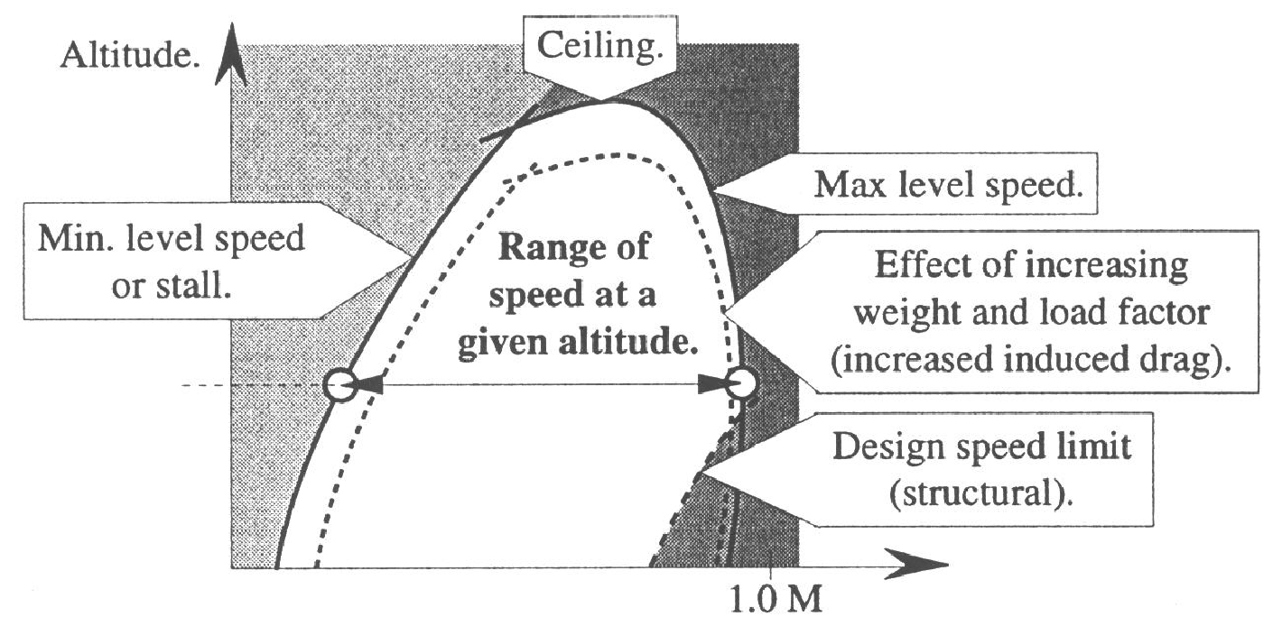
THE SPEED ENVELOPE (cont)
We can now easily understand that both low speed and high speed buffet limitations exist for aircraft operating at the higher end of the subsonic range or at very high flight levels.
Operating at higher aircraft mass makes the limitations more severe than at lower aircraft mass.
The diagram below visually demonstrates the progressively limiting nature of higher flight levels.
The dashed line illustrates the aggravation of these limitations by operating at increased aircraft mass.
**NB. Forward CG produces performance
degradation to buffet boundaries in a similar
way to an increase in aircraft mass.
mass
Notes:
‹#›

Slide 32
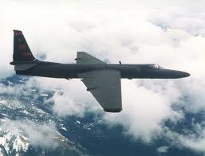
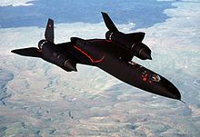
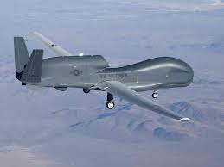
THE SPEED ENVELOPE (cont)
The three aircraft photographs in this slide illustrate the issue.
The 1960s generation U2 recconnaisance aircraft (which still operates in a research role) is powered by a single
military version of the Pratt & Whitney J T 8D which powers the B727 – it has a very low stall speed and low
induced drag (achieved by a straight wing with very high aspect ratio), but would have serious problems above
roughly Mach 0.4 – low CAS produces overshoot / undershoot wind shear problems around jet stream activity.
The SR -71 “Blackbird” was the “darling” of USAF recconnaisance in its day (the pilots wore astronaut wings),
and was obviously designed for very high supersonic Mach numbers both at low and at very high altitude.
The Global Hawk is a contemporary generation pilotless recconnaisance aircraft powered by a single turbofan
engine and can operate well above 60000ft – not entirely dissimilar to the U2 in design geometry and airspeeds.
U2 (CEILING 85000 ft)
SR-71 (MMO = M3.2)
GLOBAL HAWK
PILOTLESS
VERY HIGH WINGSPAN CREATES LOGISTICS
PROBLEM FOR TAKE OFF & LANDING PHASE
Notes:
‹#›

Slide 33
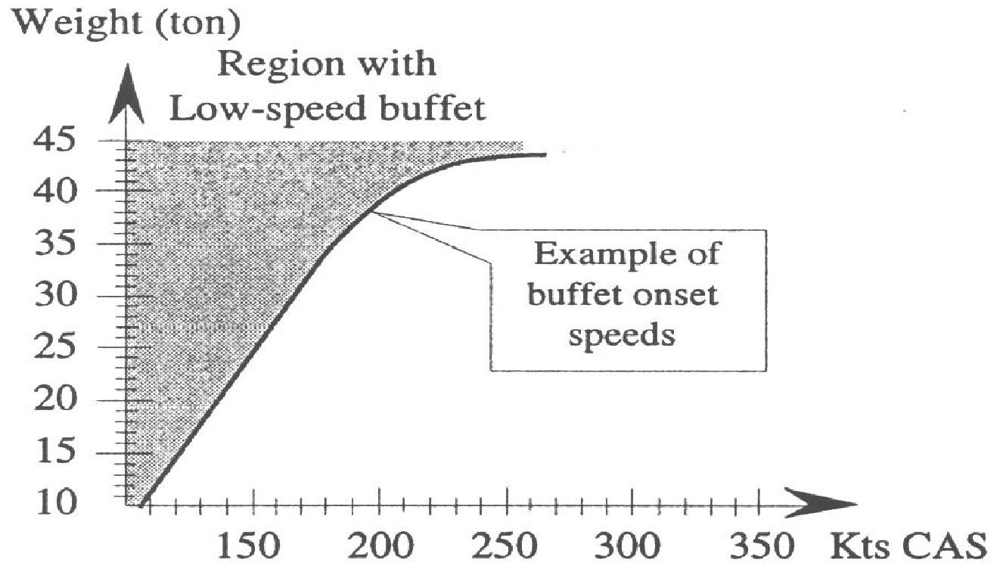
THE SPEED ENVELOPE (cont)
Stall speed EAS is proportional to the square root of the wing loading (weight / wing area), and
therefore mass increase increases stalling CAS / IAS to an even higher number.
Stall speed EAS is also proportional to the square root of the load factor N ( lift / weight), but
the diagram deals only with with wings level (and N=1) flight.
Mass
Notes:
‹#›

Slide 34
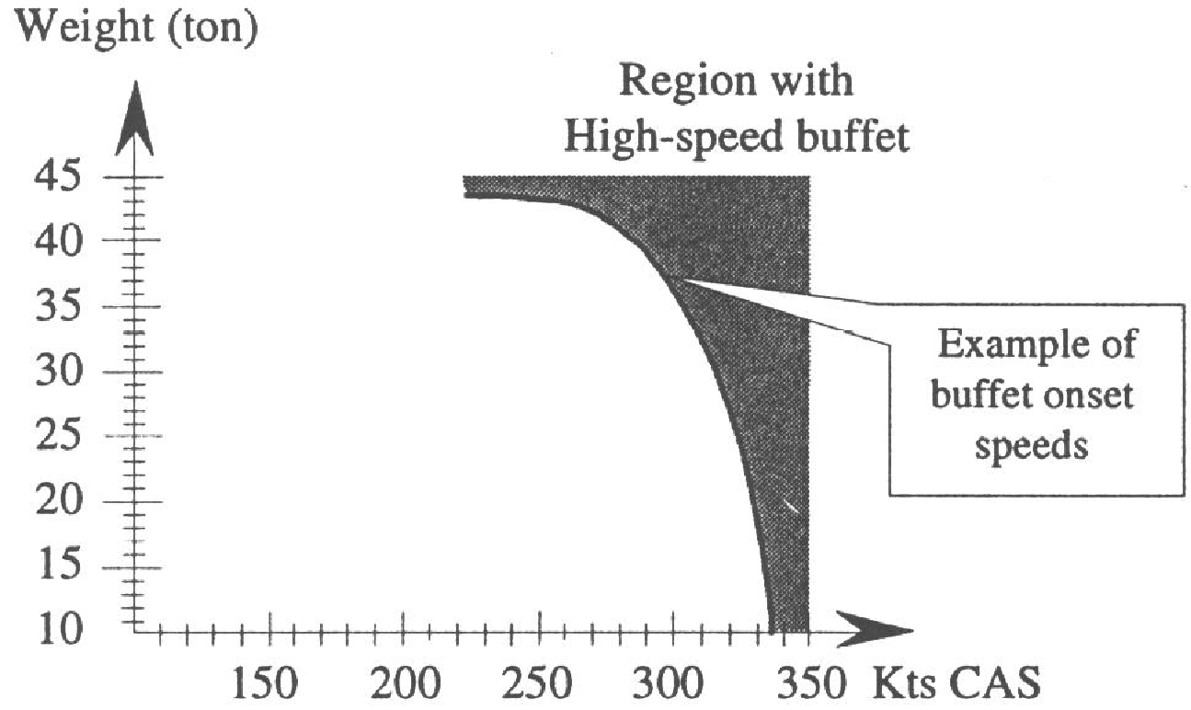
THE SPEED ENVELOPE (cont)
An increase in aircraft mass or load factor means that at any given CAS or Mach number, a greater CL is required.
This means a higher mass or load factor (N) requires a greater angle of attack for any given CAS or Mach number.
The effect is that HIGHER AIRCRAFT MASS OR LOAD FACTOR results in LOWER Mcrit.
Mass
Ma
Notes:
‹#›

Slide 35
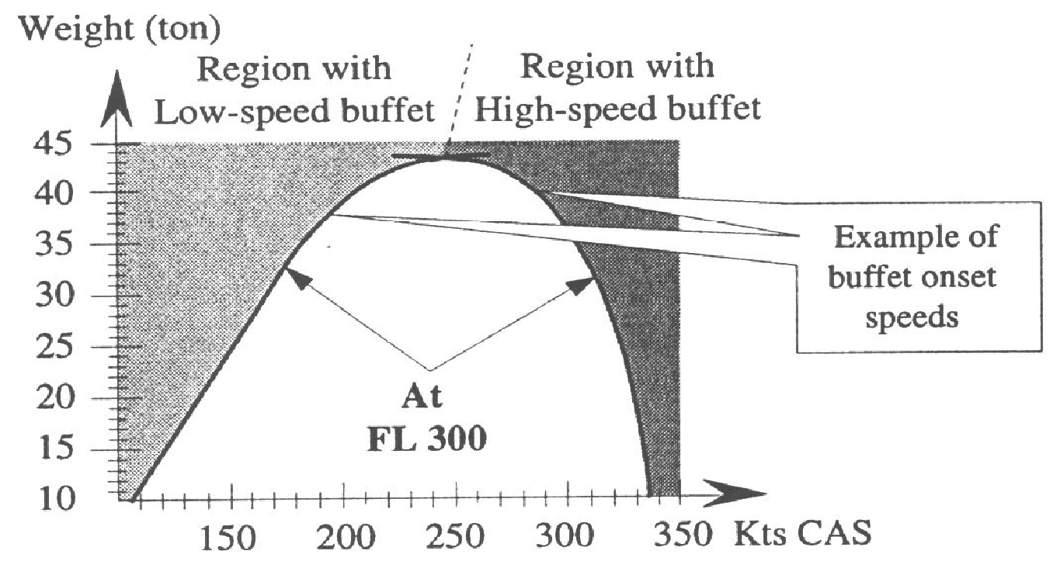
THE SPEED ENVELOPE (cont)
Any altitude increase reduces available turbine engine thrust while increasing compressibility and density correction; in turn increasing the minimum EAS and TAS for sustainable level flight. The altitude increase means that sonic speed (TAS) reduces with the lower temperatures, reducing the Mcrit TAS. Higher density correction means that Mcrit (already occuring at a lower TAS), occurs at a much lower EAS / CAS / IAS.
The diagram simplifies the issue by showing the speed envelope becoming narrower at a constant flight level (FL300) but with increasing aircraft mass. The safe speed envelope is reduced to zero at slightly less than 44 tonnes.
Operating at a higher flight level would reduce the mass for no safe speed envelope availability (“Coffin Corner”)
MASS
**NB. Higher thrust availability / utilisation
at high body angle reduces stalling speed.
Coffin corner
(Aerodynamic ceiling)
Notes:
‹#›

Slide 36
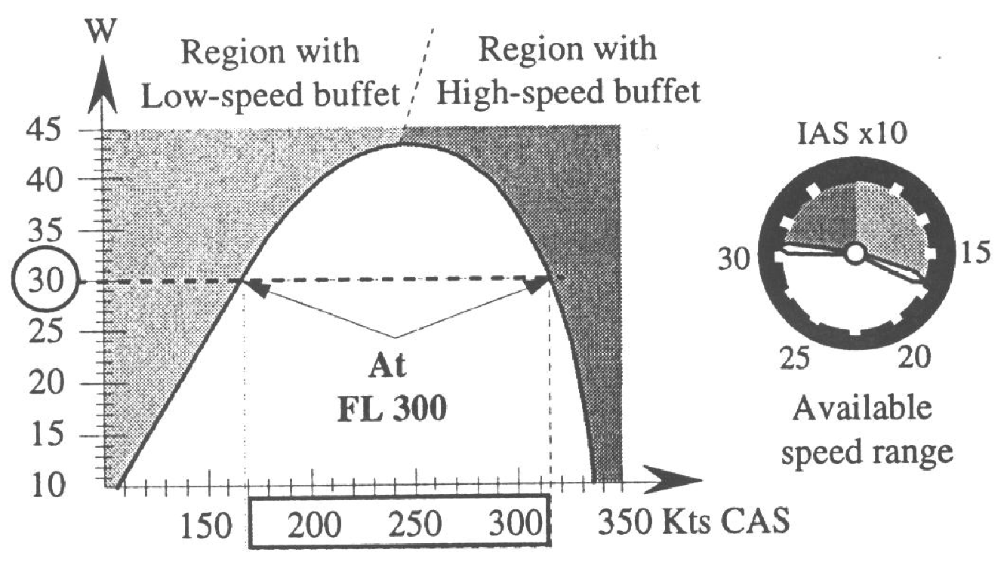
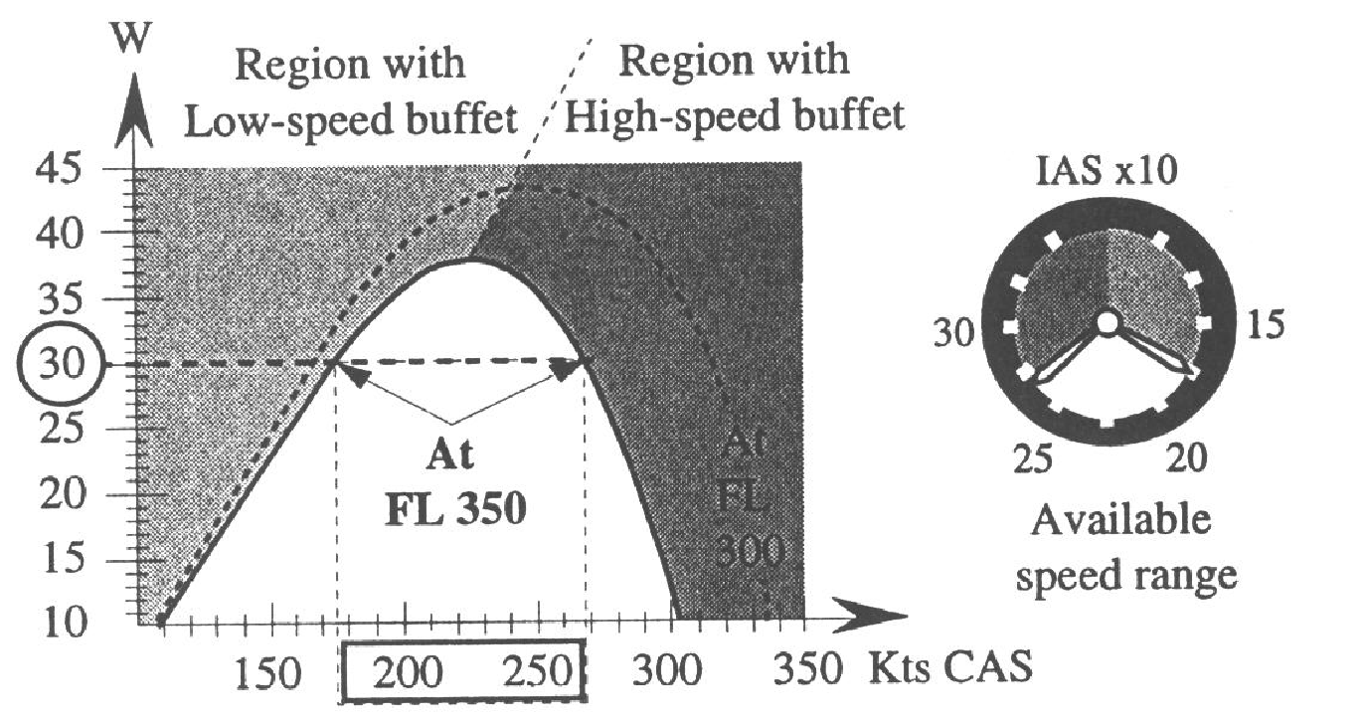
THE SPEED ENVELOPE (cont)
The following charts compare identical all up mass at different flight levels. For earlier generations of relatively “tolerant”
turbojet airliners such as a lightly loaded B727, operation above FL370 was “the exception rather than the rule”.
The charts show that use of a higher flight level narrows the available safe buffet free speed range from 145kts to 93 kts.
The examples also show opting for a higher flight level reduces the operating maximum all up mass from 43 tonnes to 38 tonnes.
Mass
FL300
AUM 30TONNES
SPEED RANGE 170-315 KCAS
MAX FLT AUM 43 TONNES
Mass
FL350
AUM 30 TONNES
SPEED RANGE 175-268 KCAS
MAX FLT AUM 38 TONNES
Notes:
‹#›

Slide 37
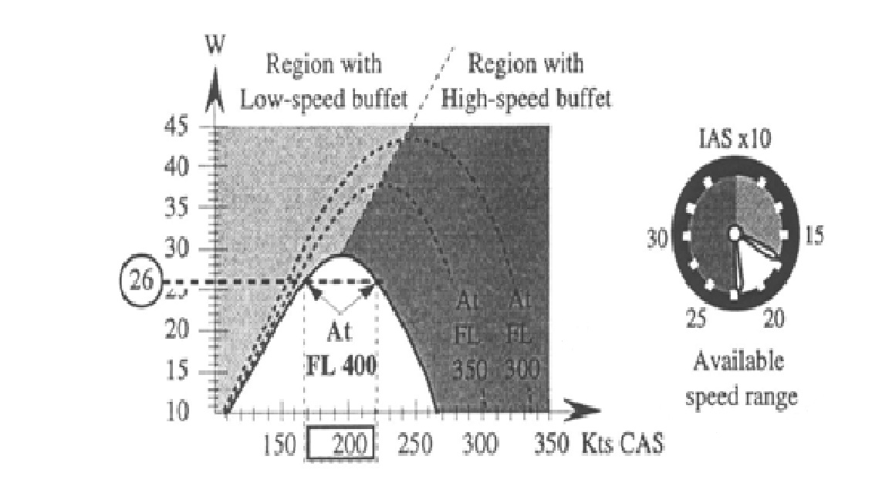
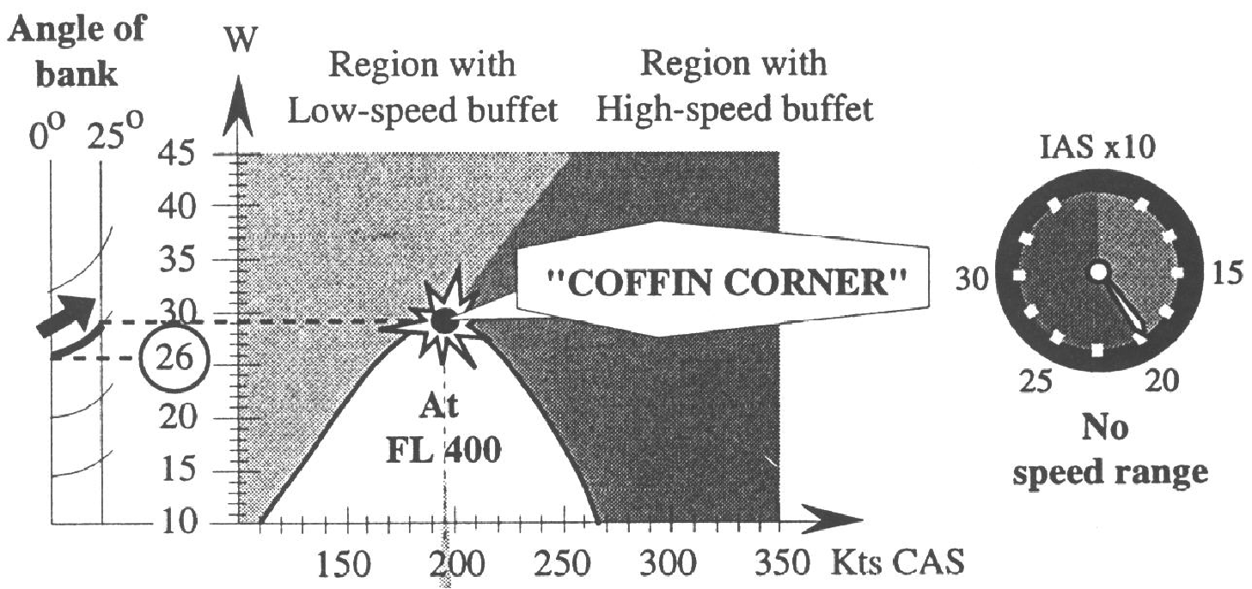
THE SPEED ENVELOPE (contd)
The use of FL 400 (very high for civil RPT jets) is illustrated in these 2 charts, showing narrow speed envelopes.
At gross mass 26 tonnes, (load factor 1), small airspeed decreases / increases produce low / high speed buffet.
The 2nd chart shows identical mass / flight level, but the aircraft now banked 25 degrees (load factor 1.1); leading
to a safe buffet free speed range of ZERO – so called “coffin corner”.
Regulations require that an aircraft be operated with a minimum buffet margin of 0.3g.
M
LOAD FACTOR 1 - SAFE, BUFFET FREE
SPEED RANGE CAS 170 – 220 KTS.
M
25 DEGREES BANK ANGLE, LOAD FACTOR 1.1 –
ZERO BUFFET FREE SPEED RANGE.
Notes:
‹#›

Slide 38
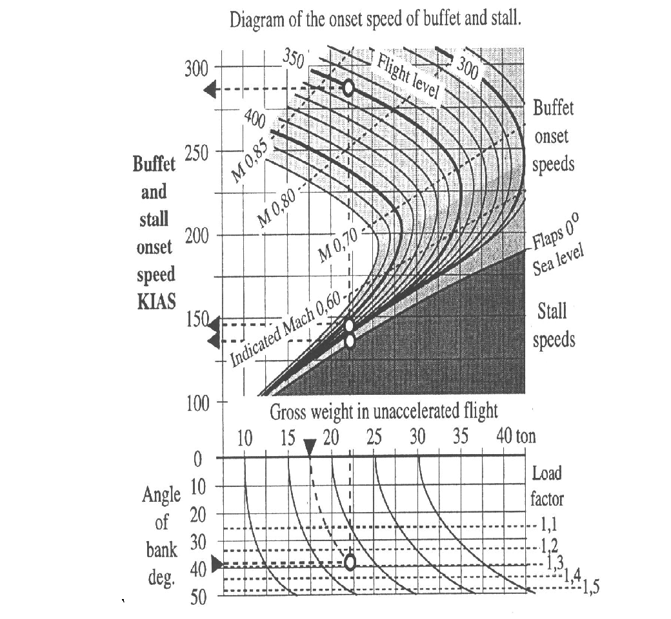
BUFFET BOUNDARY DIAGRAMS ( Low Speed Buffet And High Speed Mach Buffet )
CURVED LINES REPRESENT ALTITUDE OR FLIGHT LEVEL
HI SPEED BUFFET LIMIT & FL350
= 283 Kts IAS / M 0.83
CURVED LINES REPRESENT ALTITUDE OR FLIGHT LEVEL
LOW SPEED BUFFET LIMIT
@ FL 350 = 148 KTS IAS
STALL SPEED = 135 KTS
ONLY ZERO FLAP @ SEA LEVEL
SHOWN IN THIS CHART
mass
ENTER CHART @GROSS MASS
17..5 TONNES AND FOLLOW
CURVED LINE AS NECESSARY
FOLLOW LINE VERTICALLY
UP TO FLIGHT LEVEL
BANK ANGLE = 40 DEGREES
LOAD FACTOR = 1..31
Notes:
‹#›

Slide 39
BUFFET BOUNDARY DIAGRAMS ( Low Speed Buffet And High Speed Mach Buffet )
Previous slides have demonstrated that for any given aircraft there is a Mach number which
(even at low angle of attack) cannot be exceeded because of the onset of shock stall.
The component of dynamic energy (EAS) at right angles to the leading edge / torsional axis
is the driver of any aerodynamic reaction of whatever aerodynamic surface is under discussion.
This includes all aerodynamic reactions such as lift, drag, buffet, stall, shock waves etc.
For a given limiting Mach number, as altitude increases TAS decreases with associated temperature
decrease: when atmospherics become isothermal with altitude increase, this TAS then remains contant;
while density correction continues to increase – thus limiting EAS continues to decrease.
Flight planning an operation at a higher Mach number (still comfortably less than Mmo),
therefore limits the aircraft to a lower flight level.
Conversely, flight planning at a flight level higher than routine may very well limit flight planning a Mach
number to one that is signifigantly lower than Mmo.
The four slides which follow illustrate the same example of a buffet boundary diagram which is obviously
different to the diagram on Slide 36 (the previous slide).
The chart entry arguments are:
Flight level;
Vmo limits at the lower flight levels;
Mach number (Mmo labelled in red);
C of G expressed as % MAC;
Aircraft mass (tons);
Bank angle and load factor;
Low speed buffet Mach number.
Flight data used for examples:
M = 0.80;
FL = 350
Mass = 110 tons;
C of G = 30% MAC.
Examples provided:
1.3G flight level limits using the flight data at left;
Load factor / bank buffet onset from above data;
1.0 G low / high buffet limits @110 tons/ FL350;
Chart limit @ 110 tons with buffet limits;
Aerodynamic ceiling @ 150 tons.
Notes:
‹#›

Slide 40
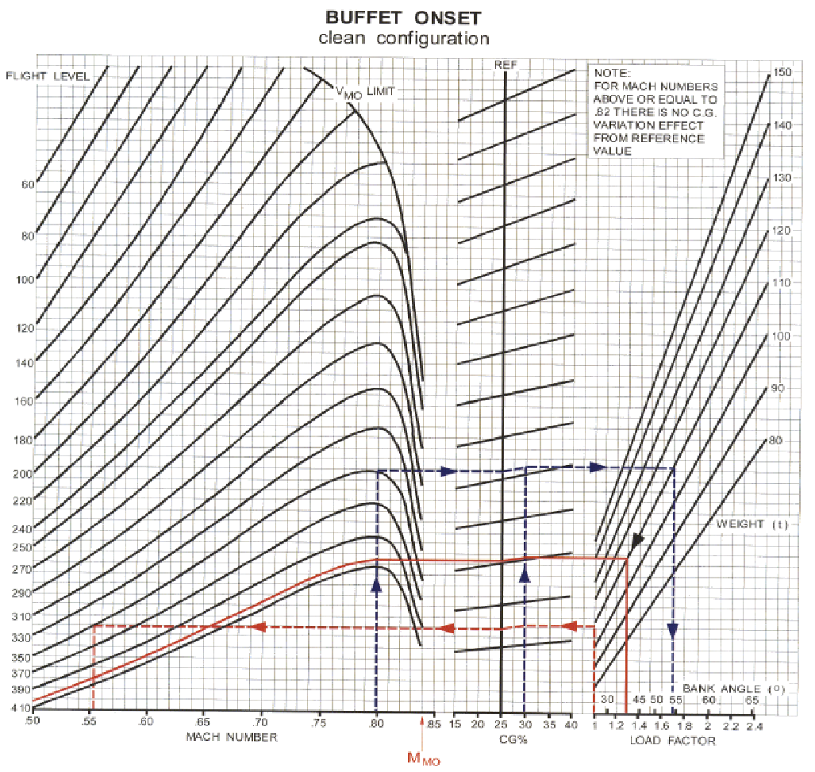
BUFFET BOUNDARY DIAGRAMS - 1.3 G FLIGHT LEVEL LIMITS @ 110 TONS; 30% C of G; M 0.80 Regulations require a minimum 0.3Gg safety margin, meaning the standard entry argument is 1.3G
REF
Note: At or above
M 0.82, no variation
in high speed buffet
onset from CG Ref 25%.
ACFT Mass = 110 tons
FL405
30% REF
1.3G altitude
= FL 405
Then here 2nd
Start here 1st

Slide 41
LOAD FACTOR / BANK ANGLE LIMITS FROM BUFFET BOUNDARY DIAGRAMS
REF
Note: At or above
M 0.82, no variation
in high speed buffet
onset from CG Ref 25%.
ACFT Mass = 110 tons
FL350
REF 25%
Start here
Buffet occurs @ 1.7g / 54°bank
Notes:
‹#›

Slide 42
1.0 G; 110 TON LOW / HIGH SPEED MACH BUFFET BOUNDARIES AT FL 350
REF
Note: At or above
M 0.82, no variation
in high speed buffet
onset from CG Ref 25%.
ACFT Mass = 110 tons
Note: At or above
M 0.82, no variation
in high speed buffet
onset from CG Ref 25%.
1 G high speed
limit @ FL350
= Mmo ( 0.84 )
because FL350
line does not
reach the entry
arguments line.
30% REF
1G Low speed
buffet @ FL 350 =
M 0.555
Start here

Slide 43
1.0 G; 110 TON LOW / HIGH SPEED MACH BUFFET BOUNDARIES AT CHART LIMIT FL410
REF
Note: At or above
M 0.82, no variation
in high speed buffet
onset from CG Ref 25%.
ACFT Mass=110 tons
At chart limit FL 410,
1G High Buffet =
M 0. 835.
Low =M 0. 67.
Start here

Slide 44
1.0 G; 150 TON LOW / HIGH SPEED MACH BUFFET BOUNDARIES & AERODYNAMIC CEILING (COFFIN CORNER)
REF
Note: At or above
M 0.82, no variation
in high speed buffet
onset from CG Ref 25%.
ACFT Mass = 150 tons
Aerodynamic ceiling
= FL395. Low speed
1G buffet limit =
M0.78. High speed 1G
limit ≤ M 0.81.
1 G high speed
limit @ FL350
= M 0.83 (25% CG).
Low speed buffet
Limit @FL350 > M0.67
30% REF
Start here
Notes:
‹#›

Slide 45
DISADVANTAGES OF THE SWEPT WING STALL – NOSE UP PITCH
The long track over the wing surface towards the tips thickens and de energises the boundary layer, exacerbating tip stall.
Lateral inwards centre of pressure movement produces forward centre of pressure movement and pitch up approaching the stall because of swept wing geometry.
The “stick shaker” is activated at 1.05 Vs.
The “stick pusher” is activated at a speed
below which level controlled flight
is unsustainable.
Spanwise flow, possibly ultimately leading to tip stalling
can be alleviated by:
Wing fences (vertical barriers on wing upper surfaces);
Vortilons (thin half chord metal barriers) and engine
pylons on wing lower surfaces;
Vortex generators and sawtooth leading edges.
Relative airflow
Relative airflow
LATERAL / FORWARD CP MOVEMENT

Slide 46
LOW SPEED STABILITY
An independent system adjusts the stabiliser to improve the low speed handling characteristics of the aircraft. This is called the SPEED STABILITY SYSTEM.
Information comes from the Angle of Attack sensor (body angle)
A/P ENGAGE
L C R
CMD
CMD
CMD
SPEED STABILITY SYSTEM
MACH TRIM SYSTEM
INHIBITED
SPEED STABILITY SYSTEM
If you engage the autopilot
or manually trim the aircraft
the SPEED STABILITY system is inhibited
STAB TRIM
STAB TRIM
HYD SYST 2
A
B
HYD SYST 3
HYDRAULIC MOTORS
SCREWJACK
STABILISER

Slide 47
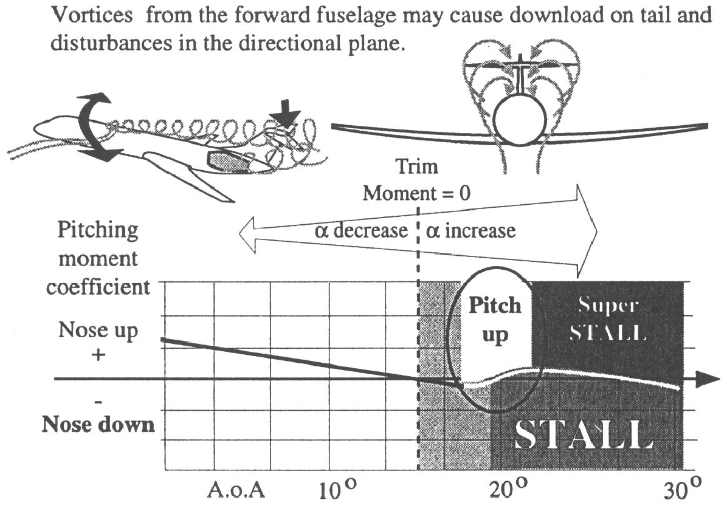
DISADVANTAGES OF A T-TAIL – AGGRAVATED PRE STALL PITCH UP
T tail designs accommodated 3 engine configurations, keeping the horizontal stabiliser above the engines. The rear mounted
engines presented design opportunities for cleaner, more efficient wings.
High body angles placed horizontal stabilisers and control surfaces in pre stall turbulence and wing downwash. Concentration of
lift coefficient at the wing root aggravated downwash, accelerating pitch up rates to levels uncontrollable by pilots; especially in consideration of reduced control effectiveness pre stall – this could lead to a potential deep / super stall with a high nose attitude.
The design is rarely if ever seen in contemporary aircraft.

Slide 48
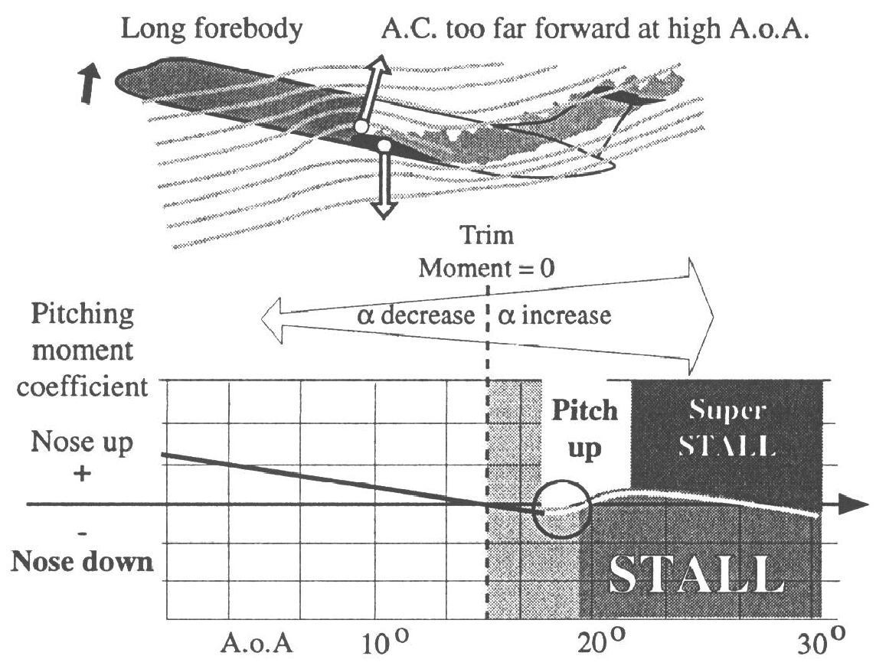
DISADVANTAGES OF A T-TAIL – AGGRAVATED PRE STALL PITCH UP
Modern jet transport aircraft all have a large long fuselage associated with aft C of G / lateral axis, and large fuselage area ahead of
the lateral axis – vortices behind the fuselage at high body angles exacerbate existing swept wing pitch up tendencies by reducing
airflow over the entire tailplane, thus reducing longitudinal and directional control effectiveness.
Tail mounted engines aggravate the aft centre of gravity problem and are more prone to turbulent fuselage wake and “flameout”.

Slide 49
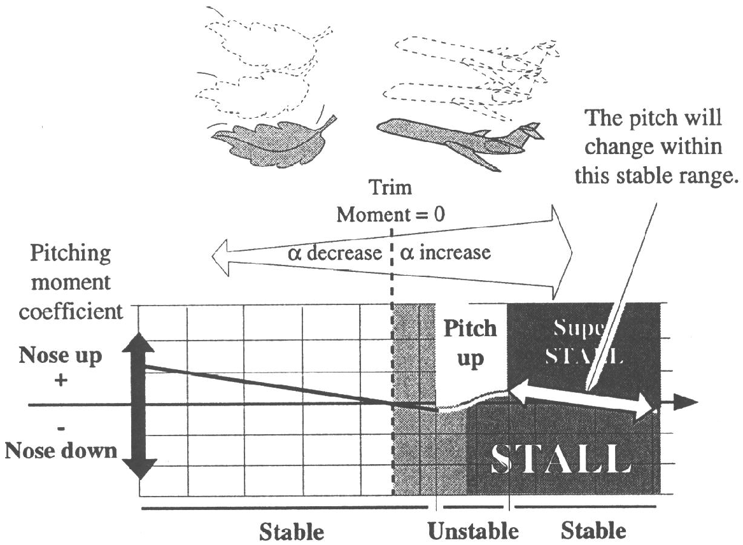
DEEP STALL / SUPER STALL
The nose up pitching moment possibly associated with a “T- tail”, rear mounted engines, AND:
swept wing / tip stalling and inward / forward centre of pressure movement;
large area of fuselage under body ahead of the centre of gravity / lateral axis;
can result in acceleration of the nose up pitch moment to the point where it is irreversible even well before the aircraft fully stalls.
Notes:
‹#›

Slide 50
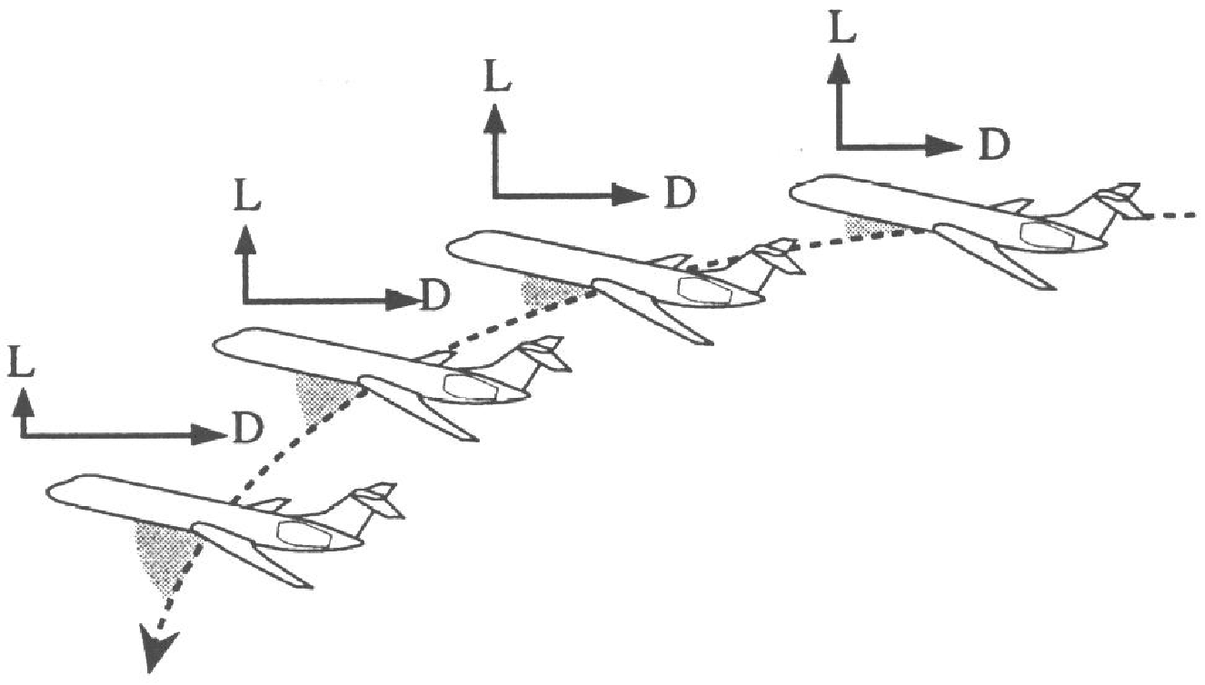
DEEP STALL / SUPER STALL
A jet transport aircraft locked in to a high body angle / angle of attack experiences a massive increase in drag
associated with reduced lift, and therefore a large reduction in lift /drag ratio.
This steepens the descent path inducing an even higher angle of attack and drag increase. The results are catastrophic loss of airspeed, and even higher sink rates.

Slide 51
Notes:
‹#›

Slide 52
Notes:
‹#›

